Slide 1
32-layer Transformer
Prompt
Engineering
Notes
JSON
20-layer frozon
Biomistral Tokenizer
12-layer for training

Slide 2
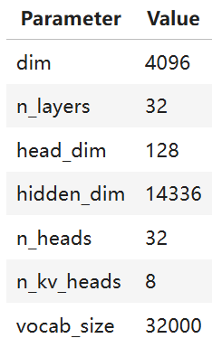
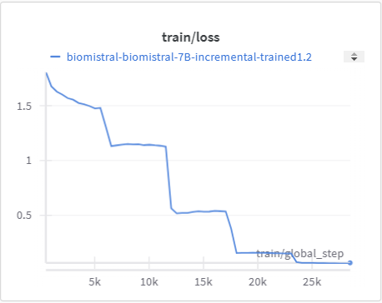
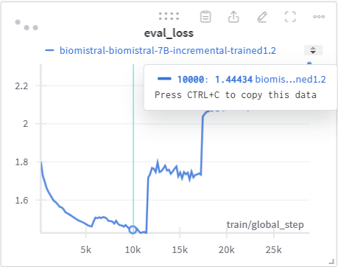
Selected
Point

